Slide 1
R Package invivoPKfit

Slide 2
invivoPKfit
invivoPKfit estimates the most likely parameter values for models describing the pharmacokinetics (PK, that is the absorption, distribution, metabolism, and elimination) of a compound given a set of in vivo concentration vs. time observations C_{obs}
This is achieved by creating a function that calculates probability of C_{obs} given a PK model M(x,t) and a statistical model S(σ)
This probability is described by a likelihood function L(C_{obs}, M, S)
We then use an optimizer function to optimize the values of x and σ such that L(C_{obs}, M(x), S(σ))
We then use the method of quadrature to estimate uncertainty in the estimates of x and σ as well as any functions of those parameters (for example, C_{max} and AUC/area under the C(t) curve)

Slide 3
Likelihood
If we have a set of N observations Obs_{1…n} and the probability of each observation is P(Obs_{i}) then the probability of the first observation is:
P(Obs₁)
The probability of the first two observations is
P(Obs₁)*P(Obs₂)
The likelihood function L is the probability of all the observations is
L = Π_{i=1,n}P(Obs_{i}) = P(Obs₁)*P(Obs₂)*…*P(Obs_{n})
Since log(A*B) = log(A) + log(B) we can write this as:
log(L) = Σ_{i=1,nlog}(P(Obs_{i})
Log-transforming is helpful because although the probabilities must sum to 1 when integrated over all parameter values, the density at any one precise set of values can be so low that a computer might round it down to zero

Slide 4

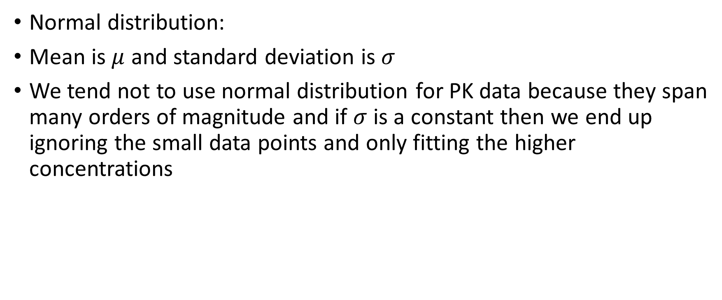
Normal Distribution
P(x, $μ$, $σ$) $=\frac{1}{σ\sqrt{2π}}e^{−\frac{1}{2}{\left(\frac{x−μ}{σ}\right)}^{2}}$
Normal distribution:
Mean is $μ$ and standard deviation is $σ$
We tend not to use normal distribution for PK data because they span many orders of magnitude and if $σ$ is a constant then we end up ignoring the small data points and only fitting the higher concentrations

Slide 5

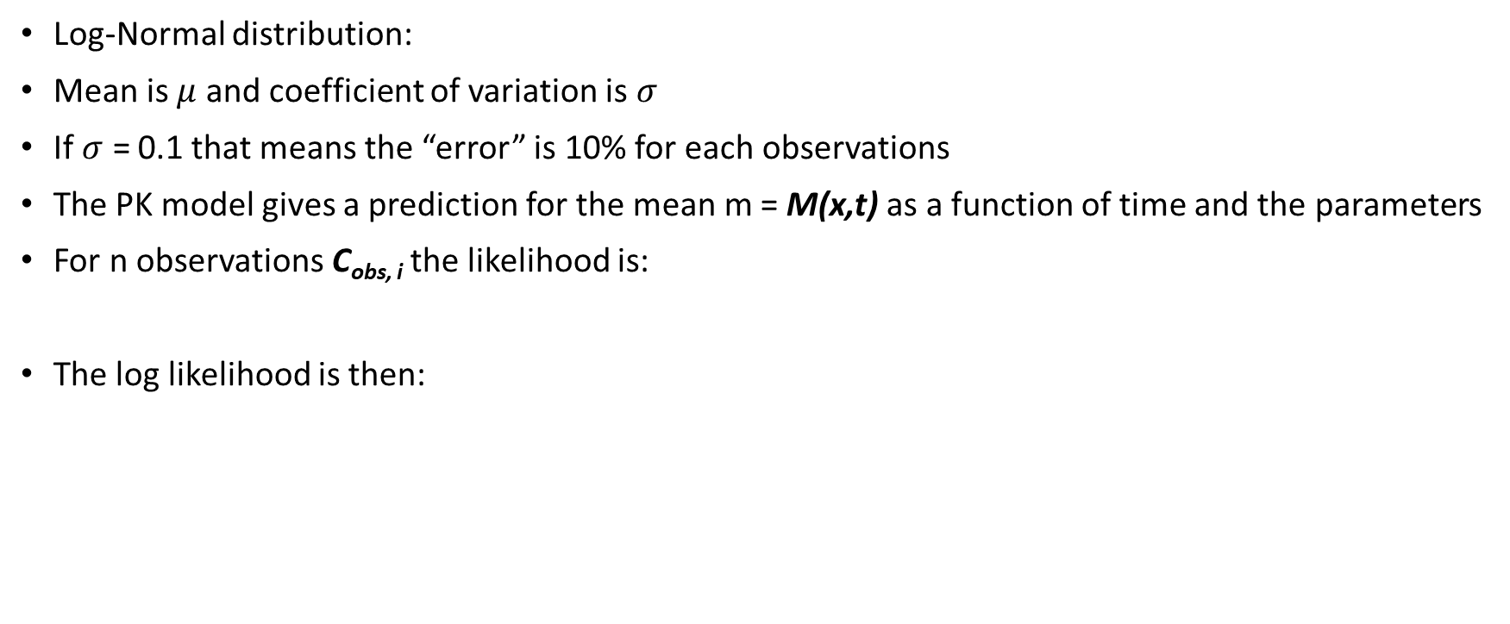
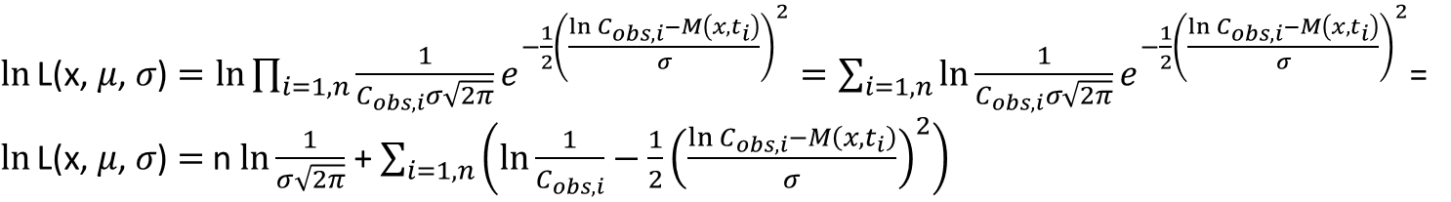
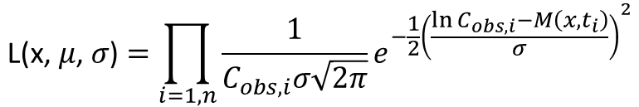
Log-Normal Distribution
Note that log(1/x) = -log(x)
P(x, $μ$, $σ$) $=\frac{1}{xσ\sqrt{2π}}e^{−\frac{1}{2}{\left(\frac{\ln{x}−μ}{σ}\right)}^{2}}$
Log-Normal distribution:
Mean is $μ$ and coefficient of variation is $σ$
If $σ$ = 0.1 that means the “error” is 10% for each observations
The PK model gives a prediction for the mean m = M(x,t) as a function of time and the parameters
For n observations C_{obs, i} the likelihood is:
The log likelihood is then:
$$\text{L}\text{(}\text{x}\text{, }μ\text{,} σ\text{)}=\prod_{i=1,n}{\frac{1}{C_{obs,i}σ\sqrt{2π}}e^{−\frac{1}{2}{\left(\frac{\ln{C_{obs,i}}−M\left(x,t_{i}\right)}{σ}\right)}^{2}}}$$
$\ln{\text{L}\text{(}\text{x}\text{, }μ\text{,} σ\text{)}}=\ln{\prod_{i=1,n}{\frac{1}{C_{obs,i}σ\sqrt{2π}}e^{−\frac{1}{2}{\left(\frac{\ln{C_{obs,i}}−M\left(x,t_{i}\right)}{σ}\right)}^{2}}}}=\sum_{i=1,n}{\ln{\frac{1}{C_{obs,i}σ\sqrt{2π}}e^{−\frac{1}{2}{\left(\frac{\ln{C_{obs,i}}−M\left(x,t_{i}\right)}{σ}\right)}^{2}}}}$=
$\ln{\text{L}\text{(}\text{x}\text{, }μ\text{,} σ\text{)}}=$n $\ln{\frac{1}{σ\sqrt{2π}}}$ + $\sum_{i=1,n}{\left(\ln{\frac{1}{C_{obs,i}}}−\frac{1}{2}{\left(\frac{\ln{C_{obs,i}}−M\left(x,t_{i}\right)}{σ}\right)}^{2}\right){}}$

Slide 6
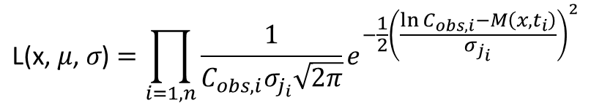

Interstudy Variability Model
If there are j studies we allow each study to have its own $σ$_{j}
Each C_{obs,i} has a time t_{i} and a coefficient of variation 𝜎_{j(i)}
$$\text{L}\text{(}\text{x}\text{, }μ\text{,} σ\text{)}=\prod_{i=1,n}{\frac{1}{C_{obs,i}σ_{j_{i}}\sqrt{2π}}e^{−\frac{1}{2}{\left(\frac{\ln{C_{obs,i}}−M\left(x,t_{i}\right)}{σ_{j_{i}}}\right)}^{2}}}$$

Slide 7
Interstudy Variability Model
Joint PK Parameter Estimates
All papers
Same Chemical, three different σs
S represents the accuracy of the analytical chemistry
All series, doses, routes from all papers used to get a single set of PK parameters.
Use these parameters to make predictions (plots) for all papers
Individual PK Parameter Estimates For Paper 1
(for example, Jones 2005)
Same Chemical, Unique σ1
All series, doses, routes used to get a single set of PK parameters
Use these parameters to make predictions (plots) just for scenarios in Paper 1
Individual PK Parameter Estimates For Paper 2
(for example, Smith 2009)
Same Chemical, Unique σ2
All series, doses, routes used to get a single set of PK parameters.
Use these parameters to make predictions (plots) just for scenarios in Paper 2
Individual PK Parameter Estimates For Paper 3
(for example, Xi 2015)
Same Chemical, Unique σ3
All series, doses, routes used to get a single set of PK parameters.
Use these parameters to make predictions (plots) just for scenarios in Paper 3
In this case we would estimate four sets of parameters for the chemical, one per paper and one joint set.
Make one plot per route and per paper (one line per dose in the plot) (we ignore differences between animals, vehicle, etc. right now)

Slide 8

Censored Data
If the observation is that the concentration was below a limit of quantitation (LOQ) we call the observation “censored”
In this case we add to the likelihood all the probability from zero to the limit of quantitation
We use the cumulative distribution function of the log-normal distribution for this:
We separate the observations into those above the LOQ and below the LOQ, above the LOQ we use the log-normal density, below the LOQ we use the CDF
CDF(LOQ, $μ$, $σ$) $=\frac{1}{2}+\frac{1}{2}erf\left(\frac{\ln{LOQ}−μ}{\sqrt{2}σ}\right)$

Slide 9
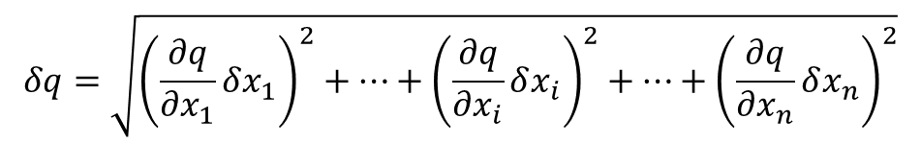
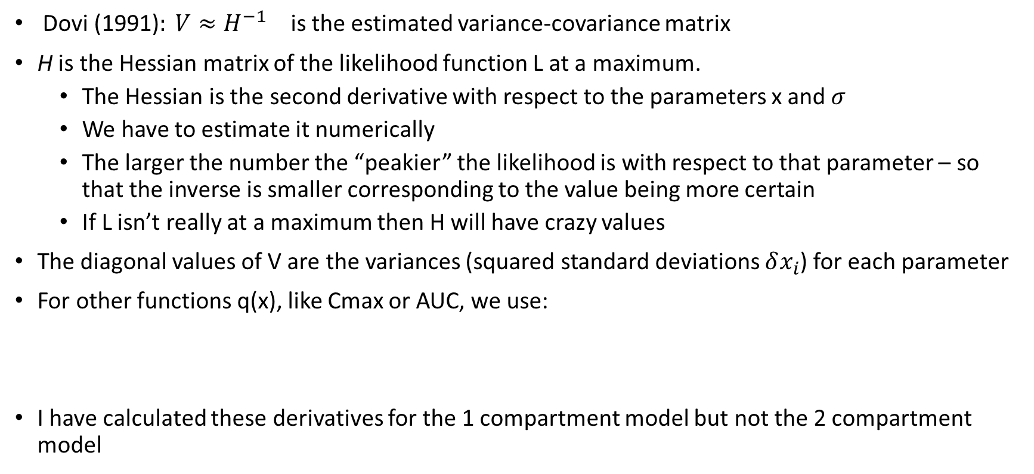
Quadrature for Uncertainty Analysis
${\text{Dovi}\text{ (1991)}: V≈H^{−1}}_{}$ is the estimated variance-covariance matrix
H is the Hessian matrix of the likelihood function L at a maximum.
The Hessian is the second derivative with respect to the parameters x and $σ$
We have to estimate it numerically
The larger the number the “peakier” the likelihood is with respect to that parameter – so that the inverse is smaller corresponding to the value being more certain
If L isn’t really at a maximum then H will have crazy values
The diagonal values of V are the variances (squared standard deviations $δx_{i}$) for each parameter
For other functions q(x), like Cmax or AUC, we use:
I have calculated these derivatives for the 1 compartment model but not the 2 compartment model
$$δq=\sqrt{{\left(\frac{∂q}{∂x_{1}}δx_{1}\right)}^{2}+…+{\left(\frac{∂q}{∂x_{i}}δx_{i}\right)}^{2}+…+{\left(\frac{∂q}{∂x_{n}}δx_{n}\right)}^{2}}$$

Slide 10
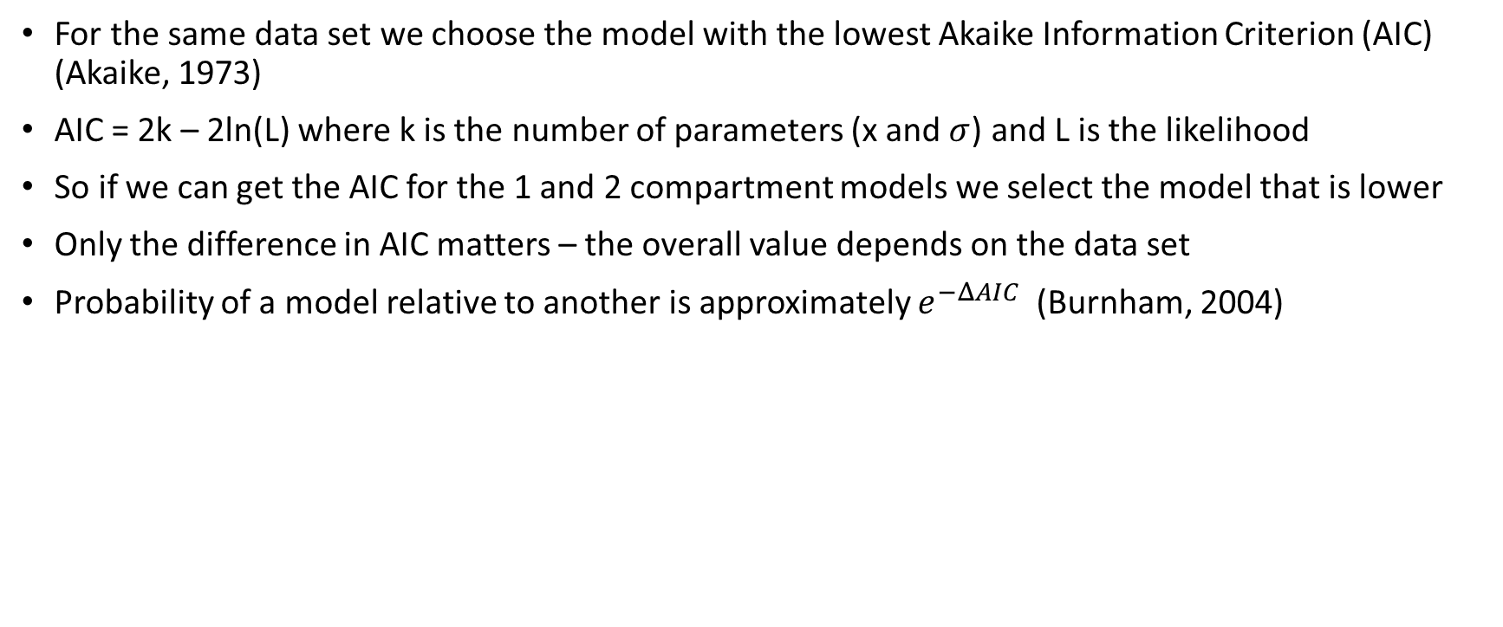
Model Selection with AIC
For the same data set we choose the model with the lowest Akaike Information Criterion (AIC) (Akaike, 1973)
AIC = 2k – 2ln(L) where k is the number of parameters (x and $σ$) and L is the likelihood
So if we can get the AIC for the 1 and 2 compartment models we select the model that is lower
Only the difference in AIC matters – the overall value depends on the data set
Probability of a model relative to another is approximately $e^{−ΔAIC}$ (Burnham, 2004)

Slide 11
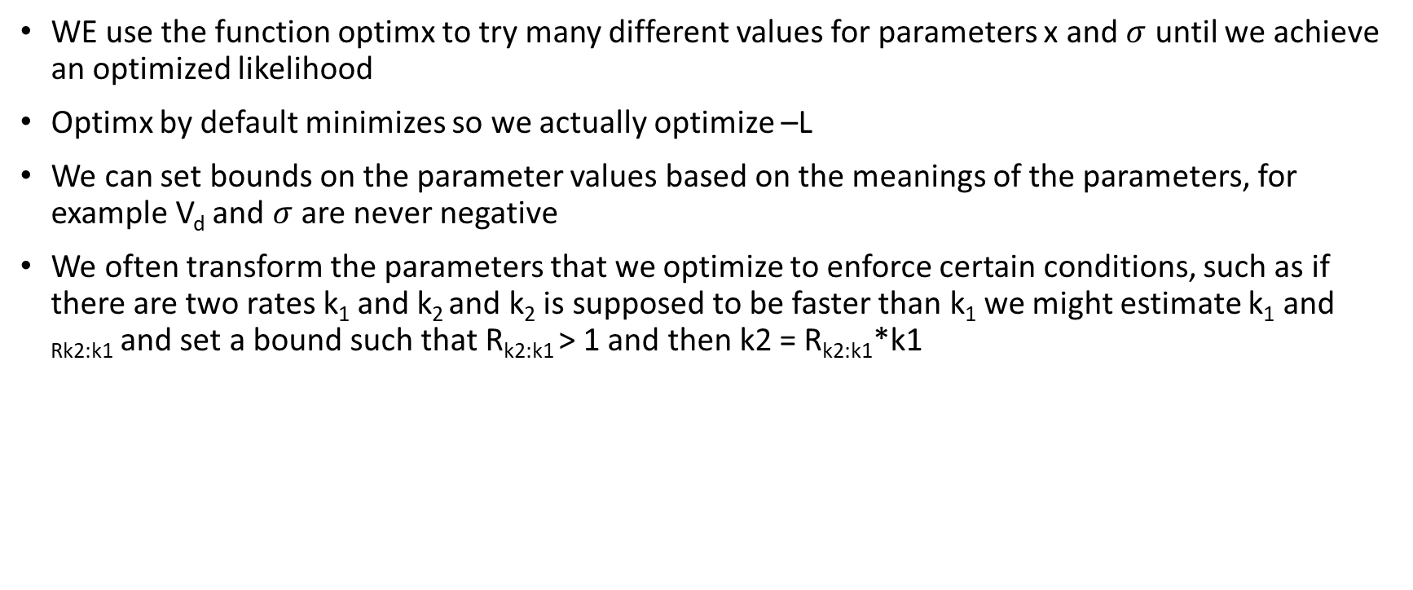
Optimizing a Function with R
WE use the function optimx to try many different values for parameters x and $σ$ until we achieve an optimized likelihood
Optimx by default minimizes so we actually optimize –L
We can set bounds on the parameter values based on the meanings of the parameters, for example V_{d} and $σ$ are never negative
We often transform the parameters that we optimize to enforce certain conditions, such as if there are two rates k₁ and k₂ and k₂ is supposed to be faster than k₁ we might estimate k₁ and _{Rk2:k1} and set a bound such that R_{k2:k1} > 1 and then k2 = R_{k2:k1}*k1

Slide 12
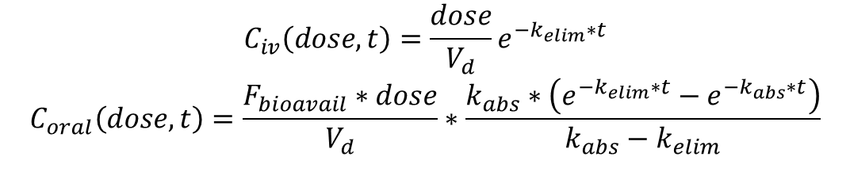
One Compartment Model
Gut Lumen
(F_{gutabs})
Primary
Compartment
(V_{dist})
Parameters are:
Vd – volume of distribution (L)
Kelim – elimination rate (1/h)
Kabs – absorption rate (1/h)
Fbioavail – fraction bioavailable
k_{gutabs}
k_{elim}
Only needed for oral doses
$$C_{iv}\left(dose,t\right)=\frac{dose}{V_{d}}e^{−k_{elim}∗t}$$
$$C_{oral}\left(dose,t\right)=\frac{F_{bioavail}∗dose}{V_{d}}∗\frac{k_{abs}∗\left(e^{−k_{elim}∗t}−e^{−k_{abs}∗t}\right)}{k_{abs}−k_{elim}}$$
Log C
intravenous
Dose/Vd
Slope = -kelim
t

Slide 13

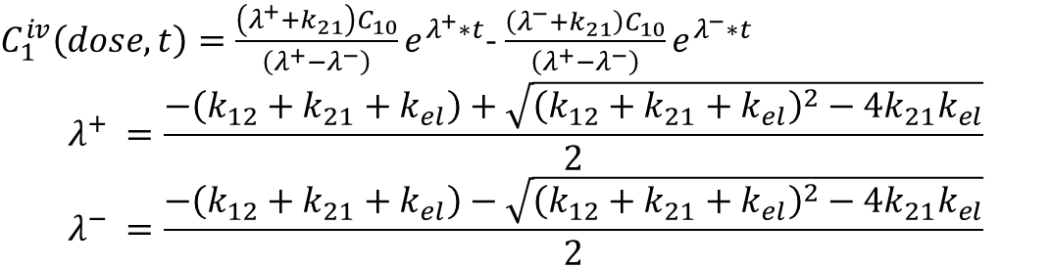

Two Compartment Model
Gut Lumen
(F_{gutabs})
Primary
Compartment
(V₁)
k_{gutabs}
k_{elim}
Parameters are:
V1 – volume of primary compartment (L)
Kelim – elimination rate (1/h)
K12 – distribution rate to deep compartment (1/h)
K21 – distribution rate from deep compartment (1/h)
Kabs – absorption rate (1/h)
Fbioavail – fraction bioavailable
k₁₂
k₂₁
Deep
Compartment
Only needed for oral doses
Note V2 = k12/k21*V1
$C_{1}^{iv}\left(dose,t\right)=\frac{\left(λ^{+}+k_{21}\right)C_{10}}{\left(λ^{+}−λ^{−}\right)}e^{λ^{+}∗t}$- $\frac{\left(λ^{−}+k_{21}\right)C_{10}}{\left(λ^{+}−λ^{−}\right)}e^{λ^{−}∗t}$
$$λ^{+} =\frac{−\left(k_{12}+k_{21}+k_{el}\right)+\sqrt{{\left(k_{12}+k_{21}+k_{el}\right)}^{2}−4k_{21}k_{el}}}{2}$$
$$λ^{−} =\frac{−\left(k_{12}+k_{21}+k_{el}\right)−\sqrt{{\left(k_{12}+k_{21}+k_{el}\right)}^{2}−4k_{21}k_{el}}}{2}$$
Log C
intravenous
Slope1 = $λ^{+}$
Dose/V1
Slope2 = $λ^{−}$
My copy of Ellen O’Flaherty’s book is at the EPA and I haven’t found a good reference for oral two compartment yet on-line, but it’s out there – essentially we multiply the whole thing by an e^ka*t term
t

Slide 14
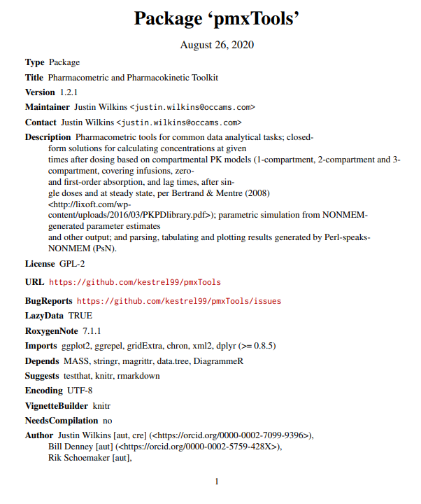
R Packages we Should Comment On
All CRAN packages on PK are listed here:
https://cran.r-project.org/web/views/Pharmacokinetics.html
We may want to check out this R package to see if it helps us with anything
We might explore replacing our own models with this tool or another similar one

Slide 15
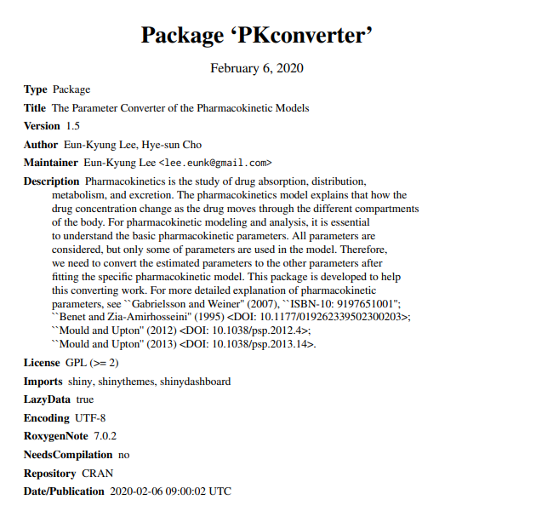
R Packages we Should Comment On
All CRAN packages on PK are listed here:
https://cran.r-project.org/web/views/Pharmacokinetics.html
We may want to check out this R package to see if it helps us with anything

Slide 16
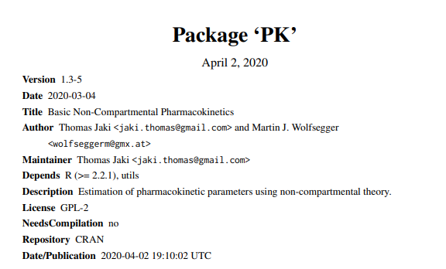
R Packages we Should Comment On
All CRAN packages on PK are listed here:
https://cran.r-project.org/web/views/Pharmacokinetics.html

Slide 17
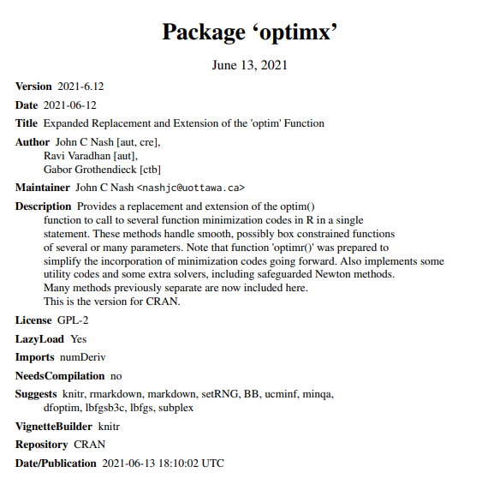
R Packages we Should Comment On

Slide 18
Peculiarities of the Package and Coming Attractions
Log-likelihood = NA and AIC = INF indicates failure to fit the model
Only the derivatives are model specific – would like to eventually make the package work for any model in HTTK
We could consider doing numerical derivatives for uncertainty propagation

Slide 19
References
Anderson, D., and K. Burnham. "Model selection and multi-model inference." Second. NY: Springer-Verlag 63.2020 (2004): 10.
Akaike, H. "Maximum likelihood identification of Gaussian autoregressive moving average models." Biometrika 60.2 (1973): 255-265.
Boxenbaum, Harold G., Sidney Riegelman, and Robert M. Elashoff. "Statistical estimations in pharmacokinetics." Journal of pharmacokinetics and biopharmaceutics 2.2 (1974): 123-148.
Charles, Sandrine, Aude Ratier, and Christelle Lopes. "Generic solving of one-compartment toxicokinetic models." bioRxiv (2021).
Colburn, Wayne A. "Controversy III: To model or not to model." The Journal of Clinical Pharmacology 28.10 (1988): 879-888.
Dovì, V. G., O. Paladino, and A. P. Reverberi. "Some remarks on the use of the inverse hessian matrix of the likelihood function in the estimation of statistical properties of parameters." Applied Mathematics Letters 4.1 (1991): 87-90.
Sayre, Risa R., John F. Wambaugh, and Christopher M. Grulke. "Database of pharmacokinetic time-series data and parameters for 144 environmental chemicals." Scientific data 7.1 (2020): 1-10.
Sheiner, Lewis B. "Analysis of pharmacokinetic data using parametric models—1: Regression models." Journal of pharmacokinetics and biopharmaceutics 12.1 (1984): 93-117.
Sheiner, Lewis B. "Analysis of pharmacokinetic data using parametric models. II. Point estimates of an individual's parameters." Journal of pharmacokinetics and biopharmaceutics 13.5 (1985): 515-540.
Sheiner, Lewis B. "Analysis of pharmacokinetic data using parametric models. III. Hypothesis tests and confidence intervals." Journal of pharmacokinetics and biopharmaceutics 14.5 (1986): 539-555.
Wambaugh, John F., et al. "Evaluating in vitro-in vivo extrapolation of toxicokinetics." Toxicological Sciences 163.1 (2018): 152-169.
Yamaoka, Kiyoshi, Terumichi Nakagawa, and Toyozo Uno. "Application of Akaike's information criterion (AIC) in the evaluation of linear pharmacokinetic equations." Journal of pharmacokinetics and biopharmaceutics 6.2 (1978): 165-175.

